Slide 1
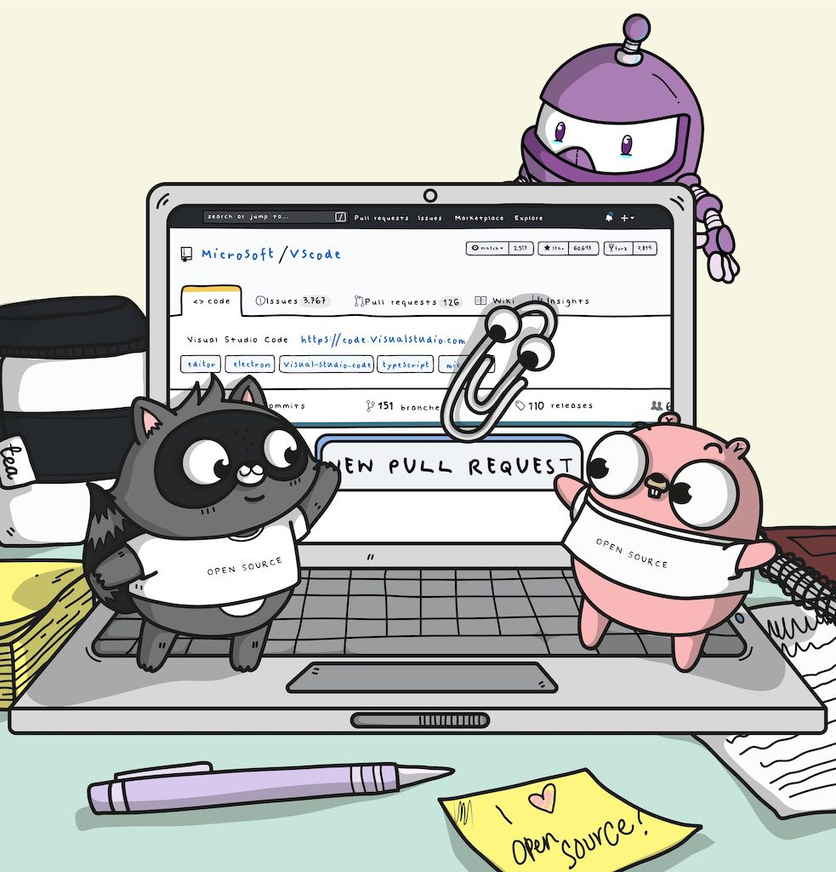
Hacking on docs.microsoft.com Dave Glover (@dglover) Microsoft Cloud Developer Advocate Neil Roodyn (nsquared) linkedin.com/in/drneil
Hacktoberfest
Notes:
Why
Consolidation from multiple properties – readthedocs, msdn, technet, azure = fragmentation
Advanced capabilities – PDF download for Offline, docs by tech version – eg Powershell https://docs.microsoft.com/en-us/powershell/scripting/powershell-scripting?view=powershell-6
Tech changes fast, versions, best practices = be more agile, change is a constant

Slide 2

Why get involved
Improve existing skills
Meet people who are interested in similar things
Find mentors and teach others
Grow your reputation (and a career)
Learn people skills
It’s empowering to be able to make changes, even small ones
You can too
This Photo by Unknown Author is licensed under CC BY-SA-NC
Notes:
You can too – take these ideas and use for your own doc building needs

Slide 3

Hacktober: How to participate
Simple fix that niggle: Edit. Typos, formatting, translations etc
More complex: Fork -> Clone -> Fetch -> Push -> PR
Existing great idea or interesting project.
Contributor License Agreement (CLA) https://cla.microsoft.com
More Information on Hacktoberfest
https://aka.ms/hacktoberfestshirt
Or raise a GitHub issue
This Photo by Unknown Author is licensed under CC BY-SA-NC

Slide 4

Open at Microsoft(@OpenAtMicrosoft)
Microsoft and Open Source
“Who contributed the most to open source in 2017”
“Who really contributes to open source”
Microsoft Docs contributor guide overview
https://docs.microsoft.com/en-us/contribute
Open Source Cross Platform Docs Tools
Visual Studio Code and Docs Authoring Pack for VS Code
This Photo by Unknown Author is licensed under CC BY-SA
Notes:
MS has a massive team
We trust the community to help us make docs better
Available for all of us to contribute to
This is who we do it – you can too
Bill Buxton – things that work better together work better – as platforms become more available – open connecting stack makes us all more powerful

Slide 5

Test controller logic in ASP.NET Core
https://github.com/dotnet/docs/commits?author=pkulikov
https://github.com/dotnet/docs/commits?author=svick
Looks like an update is needed? (ml.net)
https://github.com/dotnet/docs/issues/8143
Don't call .Net Framework "full"
https://github.com/dotnet/docs/pull/7475
Update extension-methods.md #7726
https://github.com/dotnet/docs/pull/7726
Incorrect Samples
https://github.com/dotnet/docs/issues/7038
This Photo by Unknown Author is licensed under CC BY-NC-ND

Slide 6

How to Contribute to Open Source
Finding a Project
28% of OSS contributions are documentation
Typos, Formatting, or Translation
Places to start
From the docs.microsoft.com page you are on
Edit -> for simple mods
Forking -> for more complex PRs
Browse https://opensource.microsoft.com and
Filter by keyword, trending, stars, forks, tags…
Issue search: help-wanted or good-first-issue
Opensource.Microsoft.com
Filter on docs and MicrosoftDocs
.NET Docs (Contributing to .NET Docs)
This Photo by Unknown Author is licensed under CC BY-SA-NC

Slide 7
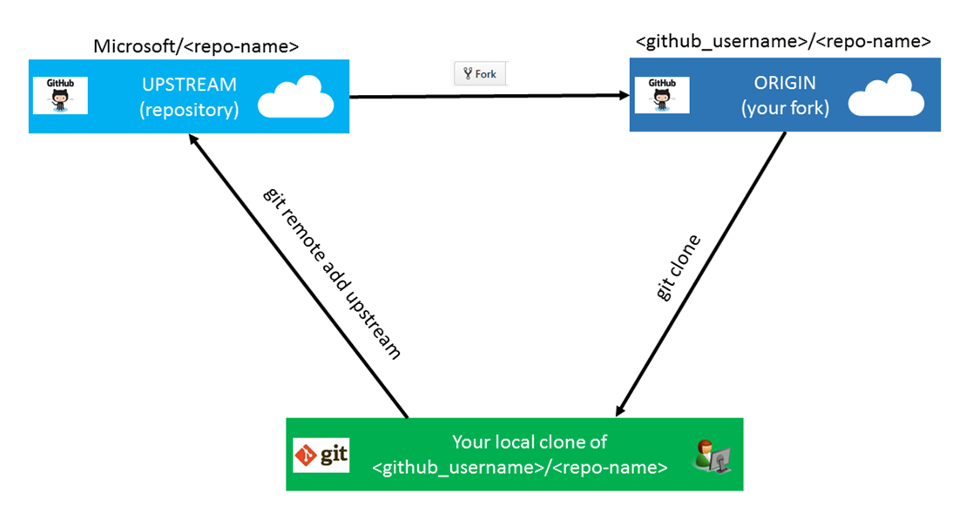
Complex Contributions First time set up
Fork own r/w copy
Clone
Set upstream
Branch
Create content
Push to origin
Pull Request to upstream
Source Tree
Tortoise Explorer

Slide 8

Visual Studio Code Docs Authoring Pack
This Photo by Unknown Author is licensed under CC BY-SA

Slide 9

Process and Acceptance
Appropriateness
Does it align with the content strategy and information architecture? Is this a scenario supported? Any legal or accessibility issues?
Technical accuracy
Any gaps? Is this the simplest way to complete the objective and would we recommend for success and cost optimization?
Editorial
Copyediting completed and possibly a Developmental Edit to ensure the content aligns with Microsoft Voice principles and Terminology Guidance
Metadata
Ensure accurate metadata – needed for reporting.
Discoverability
Is this content optimized for search? Do we have a single intent for this information?
This Photo by Unknown Author is licensed under CC BY

Slide 10

DocFX
https://dotnet.github.io/docfx

Slide 11

Resources
https://github.com/dotnet/docs/pulls
Contributing to .NET Docs
.NET API Browser (https://docs.microsoft.com/en-us/dotnet/api/)
Docs Authoring Pack for VS Code
This Photo by Unknown Author is licensed under CC BY-SA

